Slide 1

© 2007 Prentice Hall, Inc. All rights reserved.
16–<number>

Slide 2
Motivation
  Is the process by which a person’s efforts are energized, directed, and sustained towards attaining a goal.
© 2007 Prentice Hall, Inc. All rights reserved.
16–<number>

Slide 3
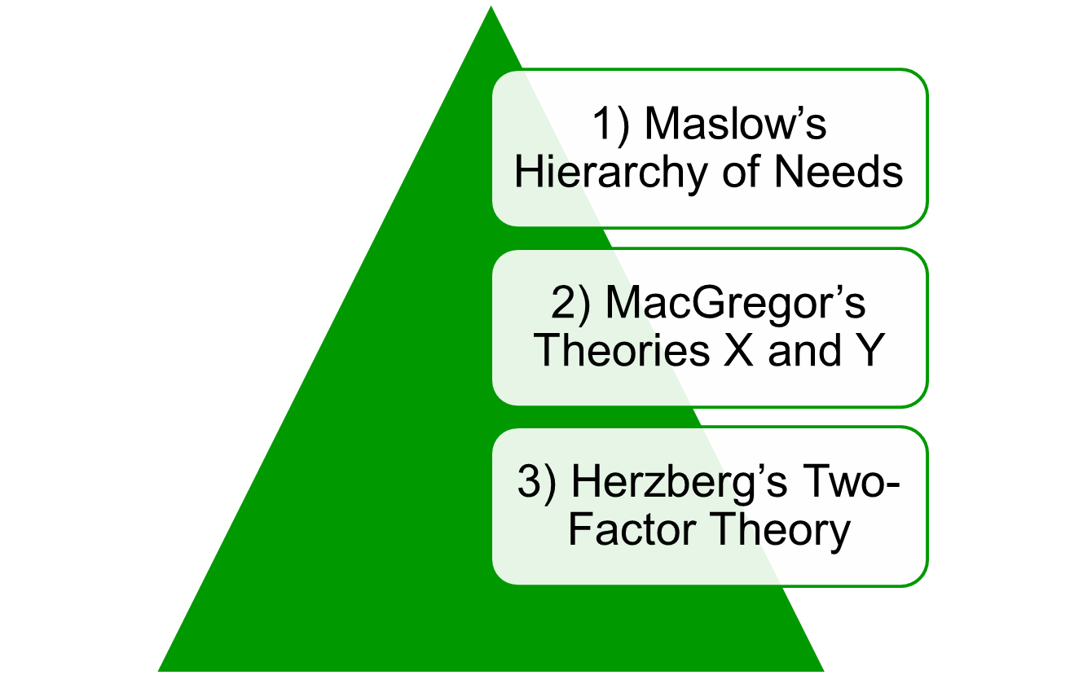
© 2007 Prentice Hall, Inc. All rights reserved.
16–<number>

Slide 4
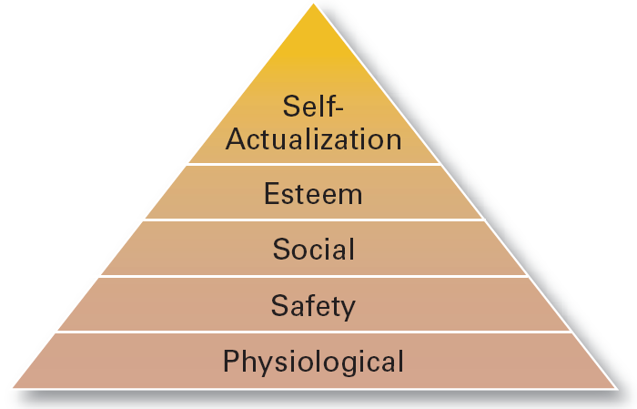
Exhibit 16–1 Maslow’s Hierarchy of Needs
© 2007 Prentice Hall, Inc. All rights reserved.
16–<number>

Slide 5
McGregor’s Theory X and Theory Y
  Theory X
    Assumes that workers have little ambition, dislike work, avoid responsibility, and require close supervision.
  Theory Y
    Assumes that workers can exercise self-direction, desire responsibility, and like to work.
  Assumption:
    Motivation is maximized by participative decision making, interesting jobs, and good group relations.
© 2007 Prentice Hall, Inc. All rights reserved.
16–<number>

Slide 6
Herzberg’s Motivation-Hygiene Theory
  Job satisfaction and job dissatisfaction are created by different factors.
    Hygiene factors: extrinsic (environmental) factors that create job dissatisfaction.
    Motivators: intrinsic (psychological) factors that create job satisfaction.
  Attempted to explain why job satisfaction does not result in increased performance.
    The opposite of satisfaction is not dissatisfaction, but rather no satisfaction.
© 2007 Prentice Hall, Inc. All rights reserved.
16–<number>

Slide 7
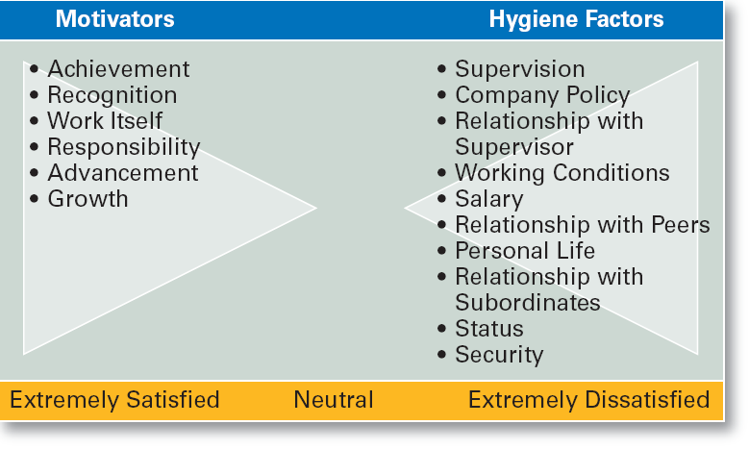
Exhibit 16–2 Herzberg’s Motivation-Hygiene Theory
© 2007 Prentice Hall, Inc. All rights reserved.
16–<number>

Slide 8
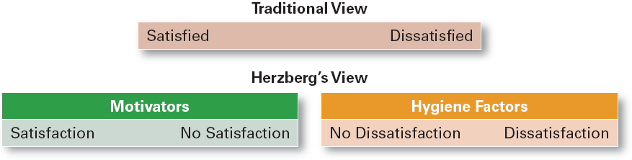
Exhibit 16–3 Contrasting Views of Satisfaction-Dissatisfaction
© 2007 Prentice Hall, Inc. All rights reserved.
16–<number>

Slide 9

Three-Needs Theory
Goal-Setting Theory
Reinforcement Theory
Designing Motivating Jobs
Equity Theory
Expectancy Theory
© 2007 Prentice Hall, Inc. All rights reserved.
16–<number>

Slide 10
Motivation and Needs
Three-Needs Theory (McClelland)
  There are three major acquired needs that are major motives in work.
    Need for achievement (nAch)
      The drive to excel and succeed
    Need for power (nPow)
      The need to influence the behavior of others
    Need of affiliation (nAff)
      The desire for interpersonal relationships
© 2007 Prentice Hall, Inc. All rights reserved.
16–<number>

Slide 11
Motivation and Goals
Goal-Setting Theory
  challenging yet achievable ----higher performance
Benefits of Participation in Goal-Setting
  Increases the acceptance of goals.
  Fosters commitment to difficult, public goals.
  Provides for self-feedback (internal locus of control) that guides behavior and motivates performance (self-efficacy).
© 2007 Prentice Hall, Inc. All rights reserved.
16–<number>

Slide 12
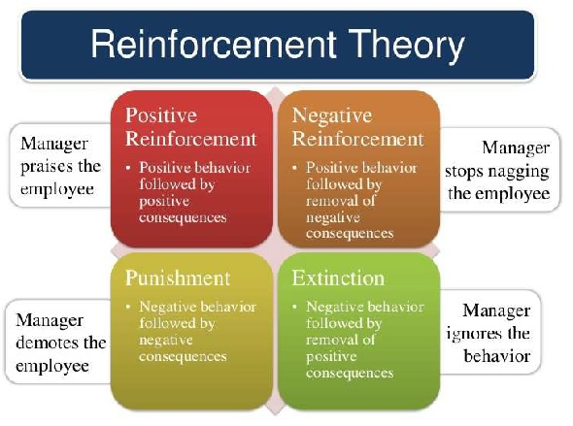
Reinforcement Theory
  Assumes that a desired behavior is a function of its consequences, is externally caused, and if reinforced, is likely to be repeated.
    Positive reinforcement is preferred for its long-term effects on performance
    Ignoring undesired behavior is better than punishment which may create additional dysfunctional behaviors.
© 2007 Prentice Hall, Inc. All rights reserved.
16–<number>

Slide 13
Designing Motivating Jobs
Job Design
  The way into which tasks can be combined to form complete jobs.
  Job enlargement
    Increasing the job’s scope (number and frequency of tasks)
  Job enrichment
    Increasing responsibility and autonomy (depth) in a job.
© 2007 Prentice Hall, Inc. All rights reserved.
16–<number>

Slide 14
Job Characteristics Model (JCM)
  A conceptual framework for designing motivating jobs that create meaningful work experiences that satisfy employees’ growth needs.
  Five primary job characteristics:
    Skill variety: how many skills and talents are needed?
    Task identity: does the job produce a complete work?
    Task significance: how important is the job?
    Autonomy: how much independence does the jobholder have?
    Feedback: do workers know how well they are doing?
© 2007 Prentice Hall, Inc. All rights reserved.
16–<number>

Slide 15
Motivation and Perception
Equity Theory
  Proposes that employees perceive what they get from a job situation (outcomes) in relation to what they put in (inputs) and then compare their inputs-outcomes ratio with the inputs-outcomes ratios of relevant others.
© 2007 Prentice Hall, Inc. All rights reserved.
16–<number>

Slide 16
Motivation and Behavior
Expectancy Theory (Vroom)
  States that an individual tends to act in a certain way based on the expectation that the act will be followed by a given outcome and on the attractiveness of that outcome to the individual.
  Key to the theory is understanding and managing employee goals and the linkages among and between effort, performance and rewards.
    Effort: employee abilities and training/development
    Performance: valid appraisal systems
    Rewards (goals): understanding employee needs
© 2007 Prentice Hall, Inc. All rights reserved.
16–<number>

Slide 17
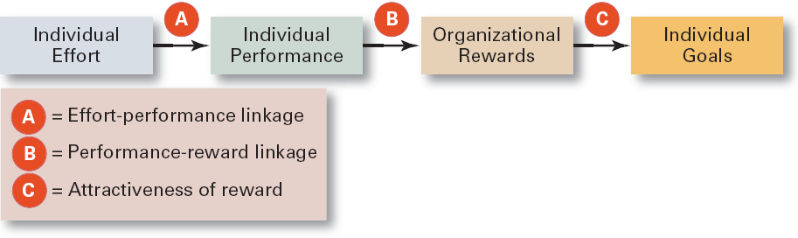
Exhibit 16–9 Simplified Expectancy Model
© 2007 Prentice Hall, Inc. All rights reserved.
16–<number>

Slide 18
Motivation and Behavior (cont’d)
Expectancy Relationships
  Expectancy (effort-performance linkage)
    The perceived probability that an individual’s effort will result in a certain level of performance.
  Instrumentality
    The perception that a particular level of performance will result in the attaining a desired outcome (reward).
  Valence
    The attractiveness/importance of the performance reward (outcome) to the individual.
© 2007 Prentice Hall, Inc. All rights reserved.
16–<number>

Slide 19
Cross-Cultural Challenges
Motivating Unique Groups of Workers
Flexible Work/Job schedules
Designing Appropriate Rewards Programs
  Pay for performance
  Employee recognition program
  Stock options
© 2007 Prentice Hall, Inc. All rights reserved.
16–<number>

